Slide 1
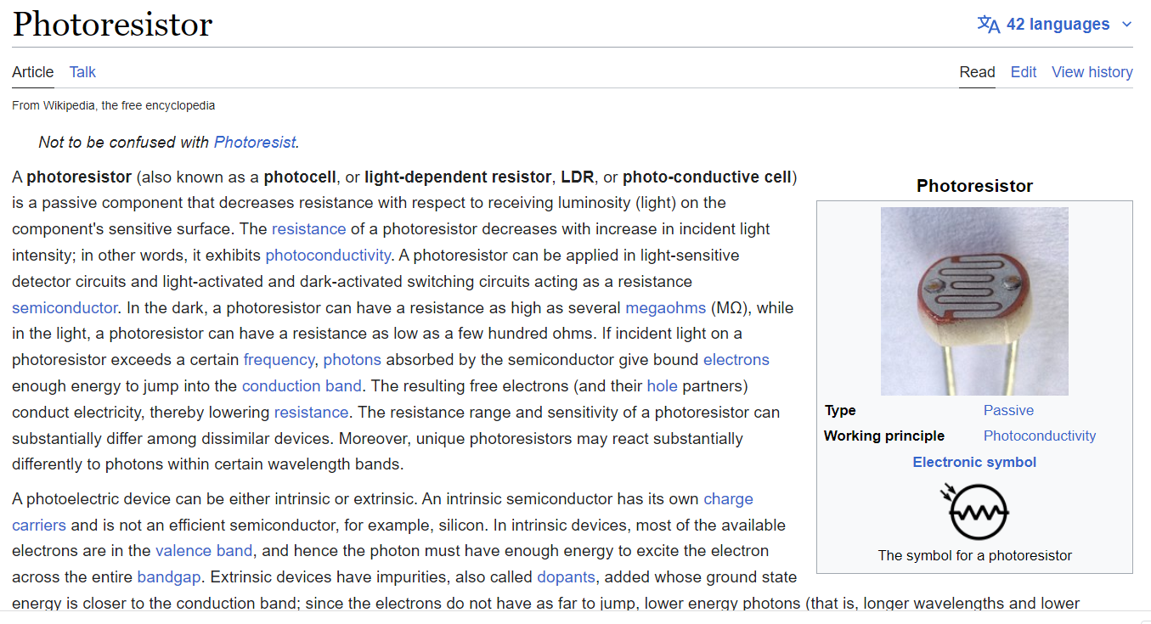
What are Photoresistors?
https://en.wikipedia.org/wiki/Photoresistor

Slide 2
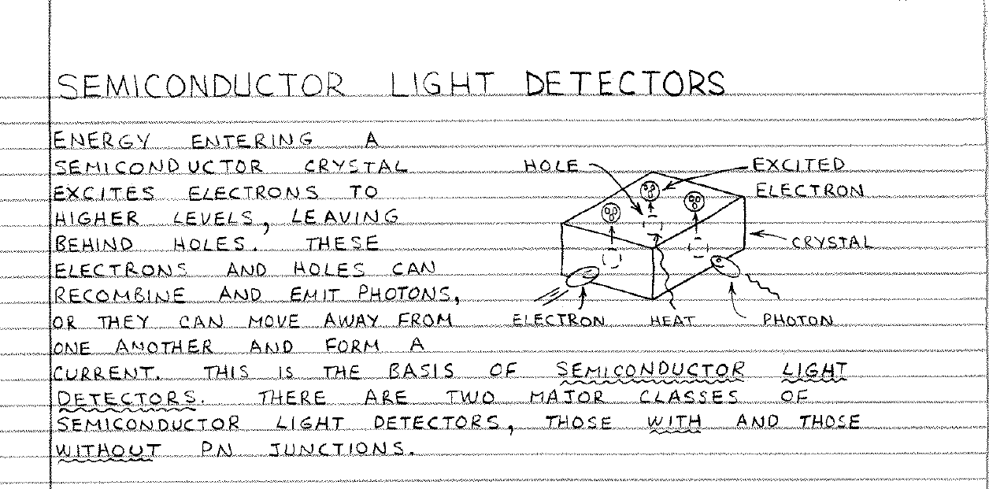
Useful Manual For Electronics: Each link brings up a section of the book. Pgs 67-80 describe photoresistors. See page 70. See page 42 for
https://www.patarnott.com/atms360/elec.htm

Slide 3
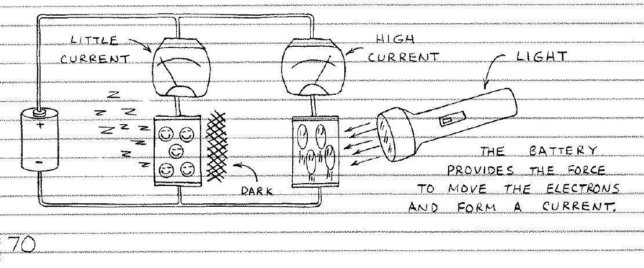
Useful Manual For Electronics: Each link brings up a section of the book. Pgs 67-80 describe photoresistors. See page 70. We won’t be using current measurements.
https://www.patarnott.com/atms360/elec.htm

Slide 4
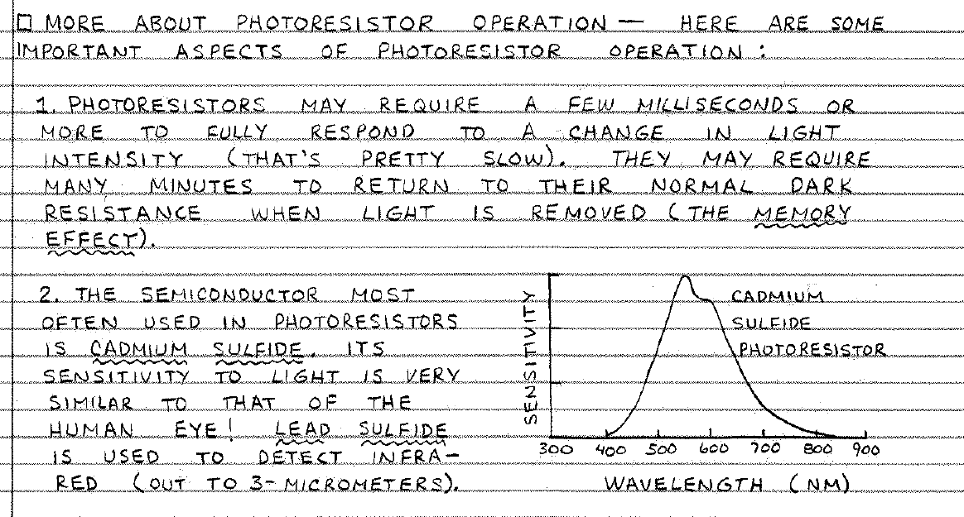
Useful Manual For Electronics: Each link brings up a section of the book. Pgs 67-80 describe photoresistors. See page 70.
https://www.patarnott.com/atms360/elec.htm

Slide 5
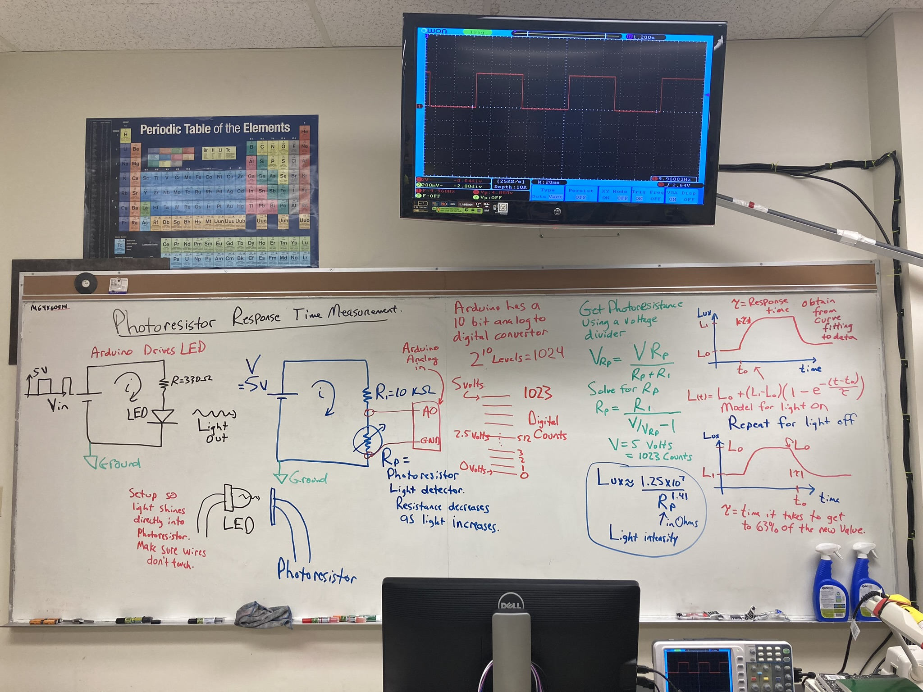

Assignment 7 Part 2

Slide 6
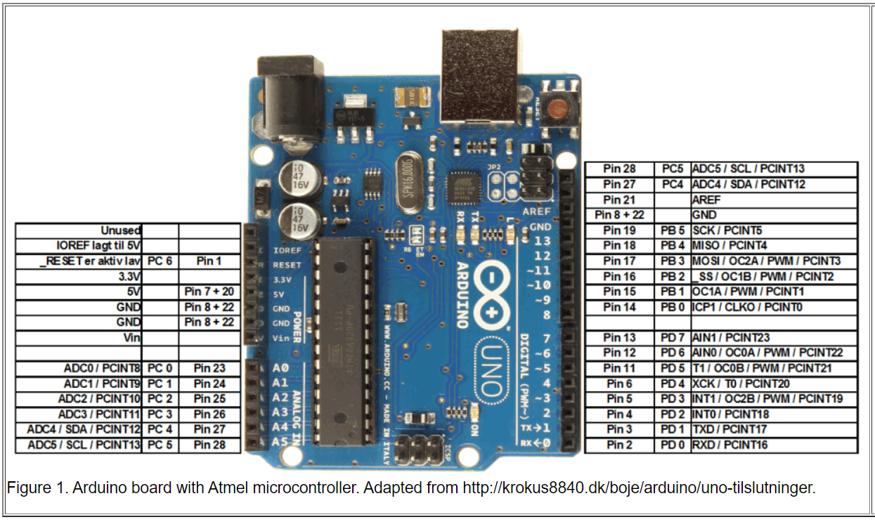
Arduino Analog Input

Slide 7
Sketch We Will Use and Manual Section on Photoresistors
https://www.patarnott.com/atms360/general/class2020/ArduinoMeasureSensorResponse_toLux/ArduinoMeasureSensorResponse_toLux.ino
https://www.patarnott.com/atms360/Arduino/general/circuits.pdf
See Circuit 6 on Photoresistors

Slide 8
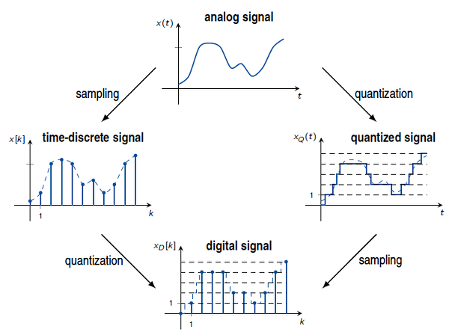
Analog versus digital signals
https://www.javatpoint.com/difference-between-analog-signals-and-digital-signals

Slide 9
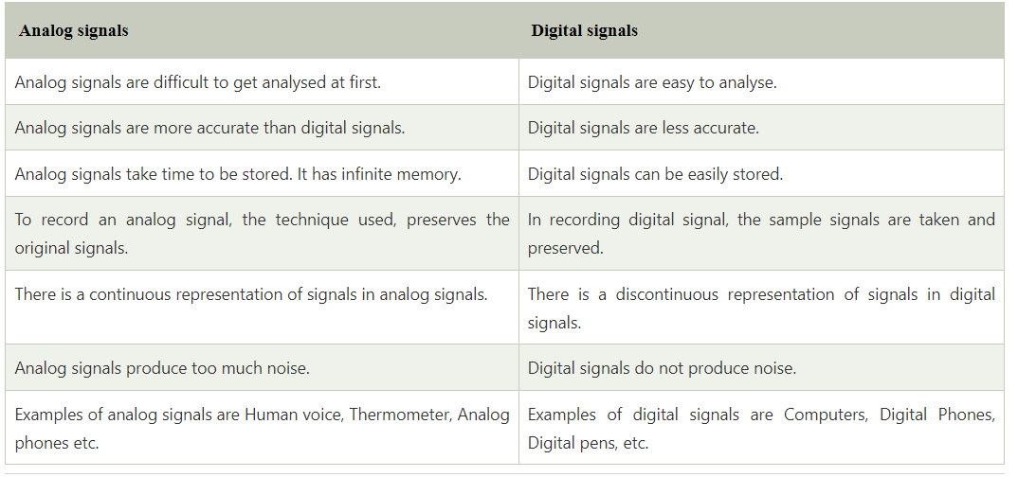
Analog versus digital signals
https://www.javatpoint.com/difference-between-analog-signals-and-digital-signals

